Slide 1



Supporting Your Child with Phonics: Read Write Inc. in Nursery & Reception
Henry Chadwick Primary School
5th October 2026
Parent Workshop

Slide 2
Welcome to Our Phonics Workshop
My Role
Purpose:
  Understanding how we teach phonics and how parents can help at home.

Slide 3
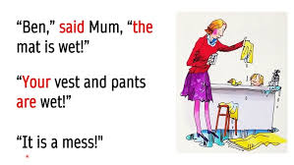
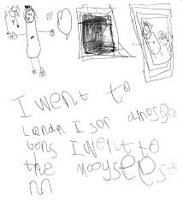
End of Reception Expectations!

Slide 4
What is Phonics?
A method for teaching children to read and write.
Focus on sounds (phonemes) and how they are written (graphemes).
Essential for early reading and spelling.

Slide 5
What Is Read Write Inc. (RWI)?
A structured, synthetic phonics programme.
Designed by Ruth Miskin.
Used in schools across the UK.
Teaches children to:
  Recognise sounds
  Blend sounds to read
  Segment words to spell
  Develop comprehension

Slide 6
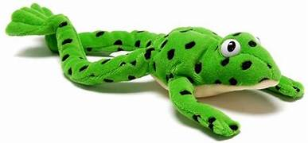
RWI in Nursery
Fred Talk
Focus on:
  Listening to sounds (environmental, instrumental, body percussion)
  Oral blending: e.g. “c-a-t” = “cat”
  Recognising and saying single letter sounds (Set 1) Summer Term
Lots of speaking, listening, singing, and story time

Slide 7
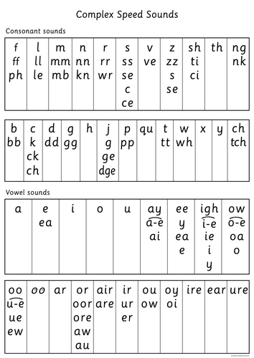


RWI in Reception
Daily phonics lessons
Learn:
  Set 1 sounds: m a s d t i n p g o c k u b f e l h sh r j v y w th z ch qu x ng nk
  How to blend sounds to read words
  Reading simple sentences
  Writing the sounds they hear in words
Use of Ditty books and then storybooks matched to their reading level

Slide 8

Sound Pronunciation
Importance of pure sounds (e.g., "mmmm" not "muh")
Here’s Sylvie showing us how it’s done!

Slide 9
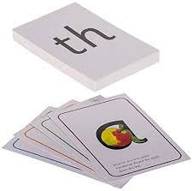
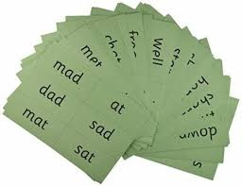
What Does a Lesson Look Like?
Review previous sounds
Introduce new sound
Practise reading and writing the sound
Use of "Fred Talk" for blending (e.g., "c-a-t")
Reading words and short sentences
Writing words and sentences

Slide 10
Key Vocabulary
Phoneme: a sound
Grapheme: a letter or group of letters that represents a sound
Blending: putting sounds together to read a word
Segmenting: breaking a word into sounds to spell
Fred Talk: saying each sound in a word to blend it

Slide 11
How We Assess Progress
Ongoing daily observations
Half-termly assessments to group children
Children move at their own pace

Slide 12


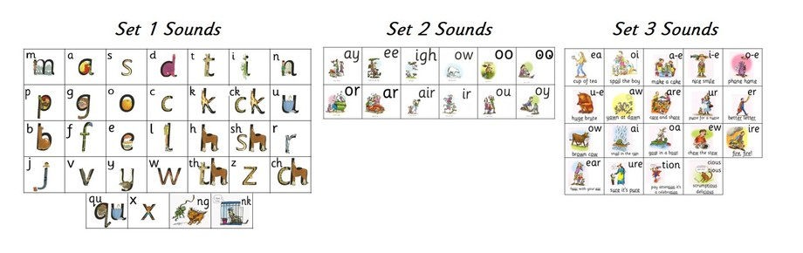
How You Can Help at Home
Practise sounds sent home in sound books
Watch sound pronunciation videos
Read daily with your child
Encourage ‘Fred Talk’ when reading unknown words
Celebrate effort and progress

Slide 13
Final Tips
Keep it fun and pressure-free
Short daily practise is best
Talk, read and play with language daily
Praise their efforts!

Slide 14
Thank You for listening, now let’s go and see phonics in action in Early Years.
Any questions?

